Slide 1

hospital management system
START
By SIDDHESH DINESH DALVI
& SURAJ NAVNATH KORDE

Slide 2
CONTENTS OF THIS PROJECT
1.. INTRODUCTION
2.. SURVEY OF TECHNOLOGY
3. REQUIREMENT OF ANAYLSIS
4. SYSTEM DESIGN
5. IMPLEMENTATION AND TESTING
6. RESULT AND DISCUSSION
7. CONCLUSION
8. REFERENCE

Slide 3
INTRODUCTION
CHAPTER NO. 1
Go!

Slide 4

1.0 INTRODUCTION
The project Hospital Management system includes registration of patients, storing their details into the system, and also computerized billing in the pharmacy, and labs.
User can search availability of a doctor and the details of a patient using the id.
The Hospital Management System can be entered using a username and password. It is accessible either by an administrator or receptionist. Only they can add data into the database. The data can be retrieved easily. The interface is very user-friendly.
It is an integrated end-to-end Hospital Management System that provides relevant information across the hospital to support effective decision making for patient care, hospital administration and critical financial accounting, in seamless flow.
Hospitals Management System enables you to develop your organization and improve it effectiveness and quality of work.

Slide 5
1.1 BACKGROUND
A Hospital is a place where Patients come up for general diseases. Hospitals provide facilities like.
Consultation by Doctors on Diseases.
Diagnosis for diseases.
Providing treatment facility.
Facility for admitting Patients (providing beds, nursing, medicines etc.)
Immunization for Patients/Children. Various operational works that are done in a Hospital.
Recording information about the Patients that come.
Generating bills.
Information about Patients is done by just writing the Patients name, age and gender. Whenever the Patient comes up his information is stored freshly.
Information about various diseases is not kept as any document. Doctors themselves do this job by remembering various medicines.

Slide 6
1.2 OBJECTIVE
Hospital management System handles activities of major departments in a hospital like:
Doctor Management
Define hospital
Recording information about the Patients that come.
Generating bills
Recording information related to diagnosis given to Patients.
Patient management (scheduling, registration and long-term care)
Patient care management and department Management.

Slide 7
1.3 PURPOSE
The health system is one of essential socio-economic activities; therefore, it requires rational and effective management. For this, it is necessary to have a tool that allows adequate control of the information generated in health institutions.
Hospital management systems allows us the ability to optimize and digitize all the processes within the institution, which will help to improve customer service, reduce process costs, streamline the search of medical records, bills, patients, doctors, etc.; thus, having a database of each module implemented
A hospital management system is a web system developed for companies that wish to manage their processes, implementing modules for each of the required areas.
In recent years, health information systems have helped improve the quality of life of people in all sectors of our society, so it is inevitable to adhere to this dizzying technological career
Currently, clinical and administrative management of hospitals and health centres is possible through a single platform, with the support of cutting-edge technology, developed to optimize the processes that allow the operation of organizations dedicated to treating patients in any branch of the medicine.

Slide 8
1.4 SCOPE
Information about Patients is done by just writing the Patients name, age and gender. Whenever the Patient comes up his information is stored freshly.
Bills are generated by recording price for each facility provided to Patient on a separate sheet and at last they all are summed up.
Diagnosis information to patients is generally recorded on the document, which contains Patient information. It is destroyed after some time period to decrease the paper load in the office.
Immunization records of children are maintained in pre-formatted sheets, which are kept in a file.
Information about various diseases is not kept as any document. Doctors themselves do this job by remembering various medicines.
All this work is done manually by the receptionist and other operational staff and lot of papers are needed to be handled and taken care of. Doctors have to remember various medicines available for diagnosis and sometimes miss better alternatives as they can’t remember the mattha at time.

Slide 9
1.5 APPLICABILITY
Achieve good quality ratings
When your hospital wants to be among the top-preferred and high-rated hospitals by insurance companies, there is no escape from hospital management system.
Better revenue management
A hospital or medical centre serves humanity, but profitability is an equally important aspect because it is a business also.
Avoid errors and track every single detail
As stated earlier, managing hospital is a crucial thing where there is no scope for errors. A manual system can’t assure full proof and 100% accurate processing.
Improved clinical decision-making
A good quality management system makes sure that operational and clinical decision-making process is fast, accurate, and efficient.

Slide 10
SURVEY OF TECHNOLOGY
CHAPTER NO. 2
Go!

Slide 11
2.1 EXISTING SYSTEM
Hospitals currently use a manual system for the management and maintenance of critical information. The current system requires numerous paper forms, with data stores spread throughout the hospital management infrastructure.
Often information is incomplete or does not follow management standards. Forms are often lost in transit between departments requiring a comprehensive auditing process to ensure that no vital information is lost. Multiple copies of the same information exist in the hospital and may lead to inconsistencies in data in various datastores.
The current manual system has a lot of paper work. To maintain the records of sale and service manually, is a Time-consuming task. With the increase in database, it will become a massive task to maintain the database. Requires large quantities of file cabinets, which are huge and require quite a bit of space in the office, which can be used for storing records of previous details.
The retrieval of records of previously registered patients will be a tedious task. Lack of security for the records, anyone disarrange the records of your system. If someone want to check the details of the available doctors the previous system does not provide any necessary detail of this type.

Slide 12
2.2 PROPOSED SYSTEM
The Hospital Management System is designed for any hospital to replace their existing manual paper-based system.
The new system is to control the information of patients.
Room availability, staff and operating room schedules and patient invoices.
These services are to be provided in an efficient, cost effective manner, with the goal of reducing the time and resources currently required for such tasks.

Slide 13
2.3 REQUIREMENT ANALYSIS
We present intelligent agent models for automated requirements gathering for computerized Hospital Management System (HMS).
In this present designs of four such agents. They are: Patient Agent, Doctor Agent, and Environment Agent.
Patient Agent:
A patient agent simulates the role of patients. The agent helps patients in consultancy about doctor selection according to his need and symptoms.
Doctor Agent:
A doctor agent plays the role of a doctor. It’s the main aim is to gather requirements of the doctor such as time saving approaches to deal with the patient and prepare report for developer.
Environment Agent:
The environment agent is responsible for the hospitality of the hospital. It maintains the arrangement of various hospital units such as wardrooms, ICUs and operating rooms.

Slide 14
2.4 HARDWARE REQUIREMENTS:
The most common set of requirements defined by any operating system or software application is the physical computer resources, also known as hardware.
A hardware requirements list is often accompanied by a hardware compatibility list (HCL), especially in case of operating systems.
An HCL lists tested, compatibility and sometimes incompatible hardware devices for a particular operating system or application.
The following sub-sections discuss the various aspects of hardware requirements.
HARDWARE REQUIREMENTS FOR PRESENT PROJECT:
PROCESSOR: Intel dual Core, I3
RAM: 1 GB
HARD DISK: 80 GB

Slide 15
2.5 SOFTWARE REQUIREMENTS:
Software Requirements deal with defining software resource requirements and pre-requisites that need to be installed on a computer to provide optimal functioning of an application.
These requirements or pre-requisites are generally not included in the software installation package and need to be installed separately before the software is installed.

Slide 16
2.6 JUSTIFICATION OF SELECTION OF TECHNOLOGY
Our present modern information system makes use of computers for the execution, each of them connected through an optimized network. Healthcare is the most critical aspect of our society, and many health care providers face challenges to offer practical and active services to patients.
Considering a ‘multi-speciality’ hospital, many people enter and exit the hospital in a day and maintaining their records safely is tedious. To reduce this type of burdens and to manage the financial, hospital administration and clinical aspects, Hospital management system came into existence.
If you are ready to implement or go with the hospital management system, make sure you follow these things before making it useful in your hospitals or labs.
Processing Speed & Results
Cost Effective
Reduction in Errors
Data Security & Retrieving Ability
Improved Patient Care
Quality & Compliance

Slide 17
REQUIREMENTS AND ANALYSIS
CHAPTER NO. 3
Go!

Slide 18
3.1 MODULE DIVISION
1- Patient Management System:
Hospital Management System developed by Solution Dots Systems provides complete assistance in patient management.
2- Doctor Management System:
Doctor Management System allows registering the doctors, working in a hospital as well as their clinic details.
3- Administrative Rights Management System:
Administrative Rights Management System includes all right of management including HR and administration.
4- Online Appointment Management System:
Online Appointment Management System allows getting online appointment instead of physical visit.
5- Invoice System:
After the appointment confirmation Invoice System generates an automatic invoice against that specific patient, this invoice helps to know about the current status of payment as well as complete payment.
6- Medical Services System:
Medical Services System allows adding a list of services that are provided by the hospital such as dental treatment service, cardiac services, mental treatment services, bones treatment services and much more.
7- Doctor Services Report System:
Doctor Services Report System allows getting complete information and management about the services of doctors.

Slide 19
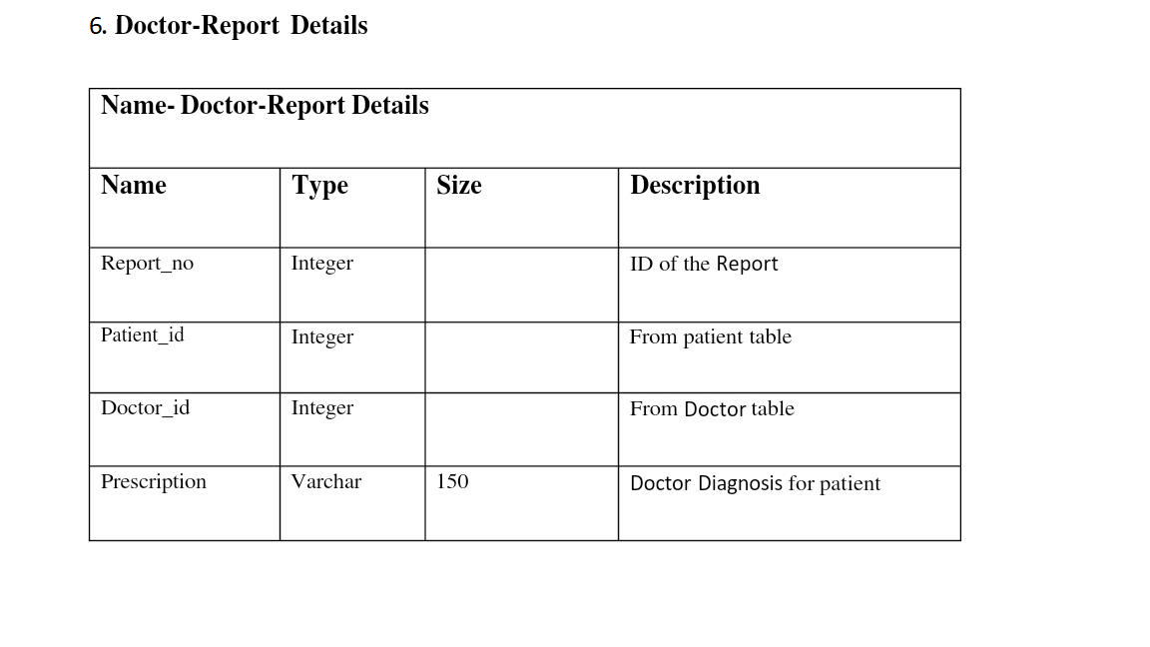
3.2 DATA DICTIONARY

Slide 20
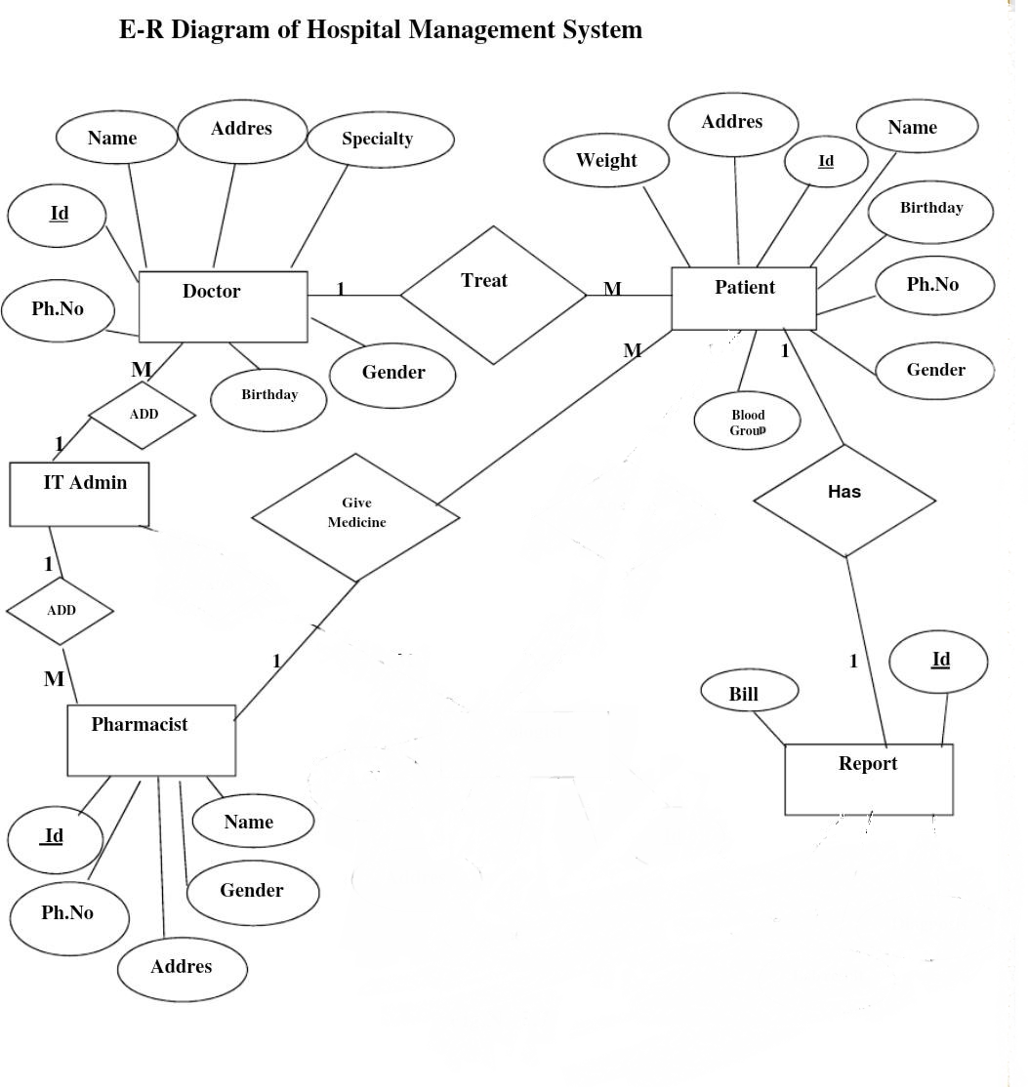
3.3 Entity-Relationship Diagram (E-R)

Slide 21
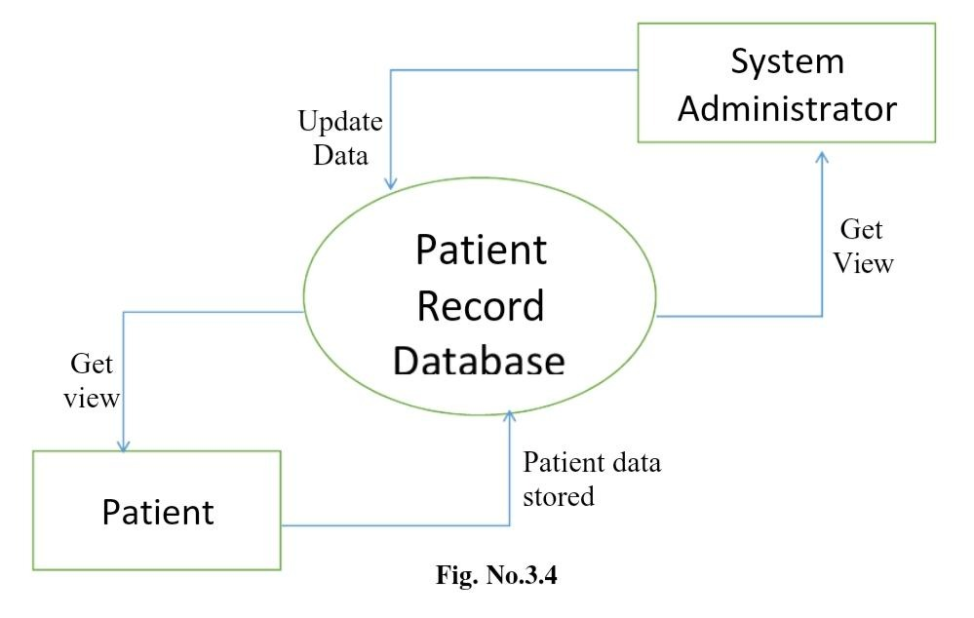
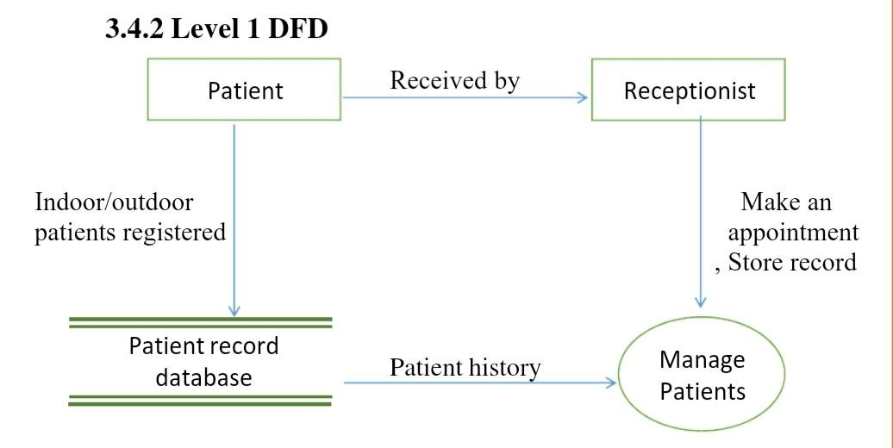
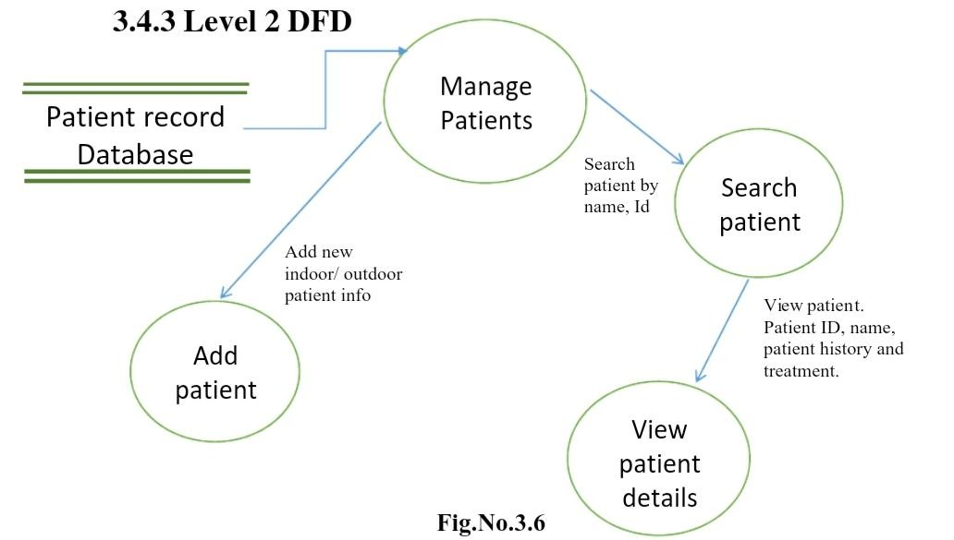
3.4 Data Flow Diagrams
3.4.0 Level 0 DFD
A context diagram is a top level (also known as Level 0) data flow diagram. It only contains one process node (process 0) that generalizes the function of the entire system in relationship to external entities.
In level 0 DFD, system is shown as one process. The Level 0 DFD shows how the system is divided into 'sub-systems'(processes), each of which deals with one or more of the data flows to or from an external agent, and which together provide all of the functionality of the whole system .and shows the flow of data between the various parts of the system.

Slide 22
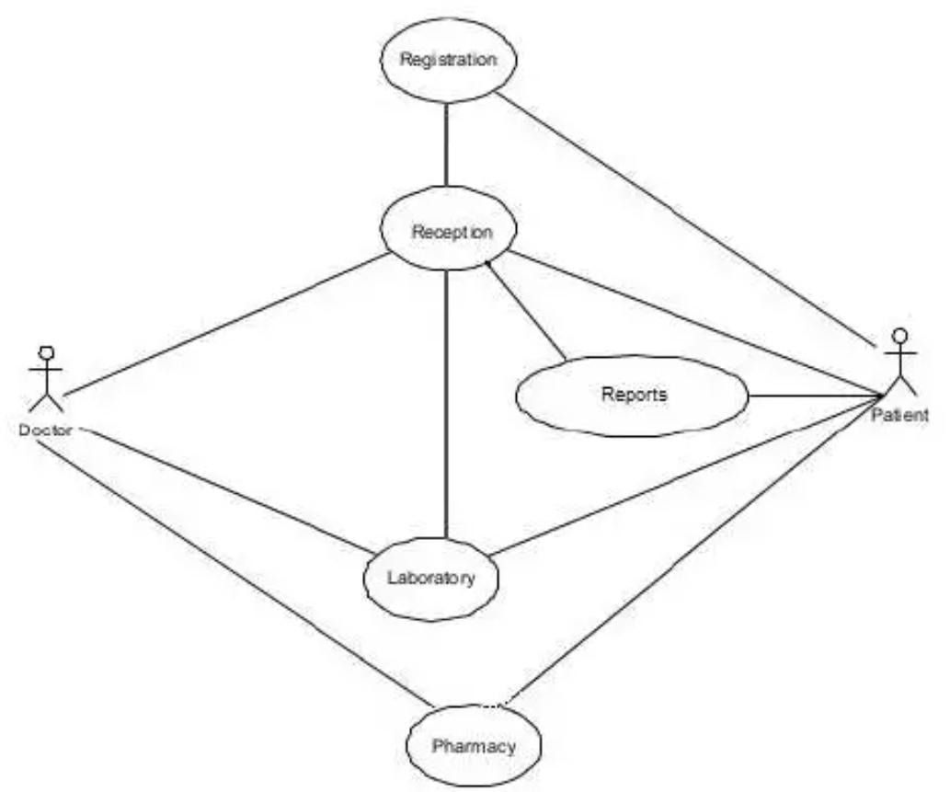
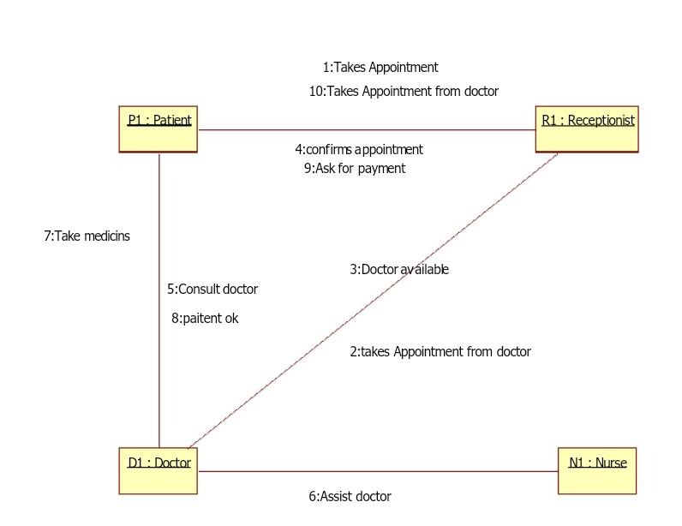
3.5 UML Diagram
Use case Diagram
Use case diagram can be useful for getting an overall view of the system and clarifying who can do and more importantly what they can't do. Use case diagram consists of use cases and actors and shows the interaction between the use cases and actors.
COLLABORATION DIAGRAM
A collaboration diagram is an introduction diagram that emphasizes the structural organization of the objects that send and receive messages. Graphically a collaboration diagram is a collection of vertices and arcs.

Slide 23
SYSTEM DESIGN
CHAPTER NO. 4
Go!

Slide 24
4.1 BASIC MODULES
Patient Agent: A patient agent simulates the role of patients. The agent helps patients in consultancy about doctor selection according to his need and symptoms. The agent gathers patient’s requirements and prepares a requirement report in the developers’ comprehensible form and sends that to him.
Doctor Agent: A doctor agent plays the role of a doctor. It’s the main aim is to gather requirements of the doctor such as time saving approaches to deal with the patient and prepare report for developer. A doctor agent also collects the advisory requirements such as suitable treatment and medication for a particular patient.
Nurse Agent: A nurse agent plays the role of a nurse. The design of nurse agent is similar to the doctor agent. A nurse agent helps a doctor agent and acts in coordination with doctor agents.
Environment Agent: The environment agent is responsible for the hospitality of the hospital. It maintains the arrangement of various hospital units such as wardrooms, ICUs and operating rooms

Slide 25
4.2 DATA DESIGN
Hospital management system database design is uploaded in this page. A database is a collection of information and is systematically stored in tables in the form of rows and columns. The table in the database has unique name that identifies its contents. The database in turn is further described in detail giving all the fields used with the data types, constraints available, primary key and foreign key.
Data types and its description:
Fields in database table have a data type. Some of the data types used in database table are explained below.
A) Integer: -
One optional sign character (+ or -) followed by at least one digit (0-9). Leading and trailing blanks are ignored. No other character is allowed.
B) Varchar: -
It is used to store alpha numeric characters. In this data type we can set the maximum number of characters up to 8000 ranges by default SQL server will set the size to 50 characters large.
C) Date/Time: -
Date/Time data type is used for representing data or time.

Slide 26
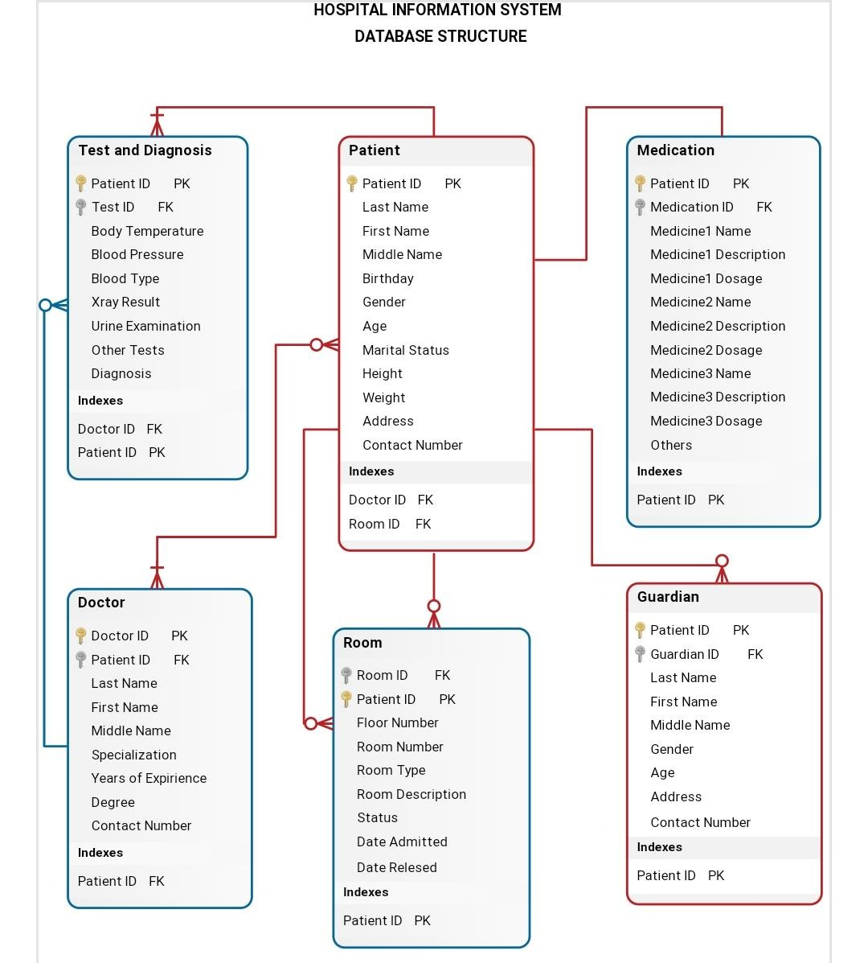
4.2.1 SCHEMA DESIGN

Slide 27
4.2.2 DATA INTEGRITY AND CONSTRAINTS
Data integrity is normally enforced in a database system by a series of integrity constraints or rules. Three types of integrity constraints are an inherent part of the relational data model: entity integrity, referential integrity and domain integrity.
Entity integrity concerns the concept of a primary key. Entity integrity is an integrity rule which states that every table must have a primary key and that the column or columns chosen to be the primary key should be unique and not null.
Referential integrity concerns the concept of a foreign key. The referential integrity rule states that any foreign-key value can only be in one of two states. The usual state of affairs is that the foreign-key value refers to a primary key value of some table in the database. Occasionally, and this will depend on the rules of the data owner, a foreign-key value can be null. In this case, we are explicitly saying that either there is no relationship between the objects represented in the database or that this relationship is unknown.
Domain integrity specifies that all columns in a relational database must be declared upon a defined domain. The primary unit of data in the relational data model is the data item. Such data items are said to be non-decomposable or atomic. A domain is a set of values of the same type. Domains are therefore pools of values from which actual values appearing in the columns of a table are drawn.

Slide 28
4.3 PROCEDURAL DESIGN 4.3.1 DATA STRUCTURES
Django data MVT Structure
Django is based on MVT (Model-View-Template) architecture. MVT is a software design pattern for developing a web application.
MVT Structure has the following three parts –
Model: Model is going to act as the interface of your data. It is responsible for maintaining data. It is the logical data structure behind the entire application and is represented by a database (generally relational databases such as MySQL, Postgres).
Django Models
View: The View is the user interface — what you see in your browser when you render a website. It is represented by HTML/CSS/JavaScript and Jinja files.
Template: A template consists of static parts of the desired HTML output as well as some special syntax describing how dynamic content will be inserted.

Slide 29
4.3.3 ALORITHMS DESIGN
STEP 1: START.
STEP 2: OPEN REGISTRATION PAGE.
STEP 3: ALLOCATE MEMORY FOR NEW PATIENT INFORMATION.
STEP 4: ENTER INFORMATION.
STEP 5: CREATE UNIQUE PATIENT ID.
STEP 6: CREATE USERNAME AND PASSWORD.
STEP 7: CREATE ENTRY TO THE DATABASE.
STEP 8: ALLOCATE DOCTOR FOR THE PATIENT.
STEP 9: TESTS AND REPORTS ENTRY.
STEP 10: INITIATE ADVANCE FEES.
STEP 11: ALLOCATION OF BED AND ROOM FOR PATIENT.
STEP 12: PATIENT HEALTH PROGRESS.
STEP 13: PATIENT DISCHARGE.
STEP 14: PENDING FEES AND UPDATION.
STEP 15: END.

Slide 30
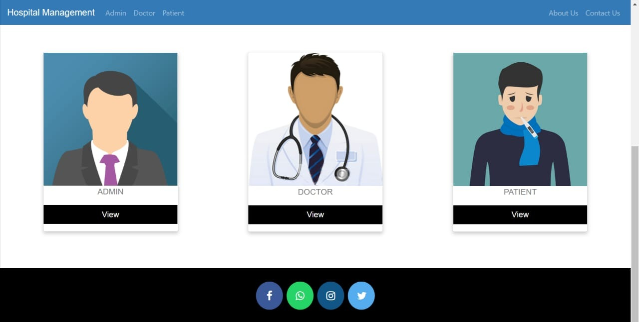
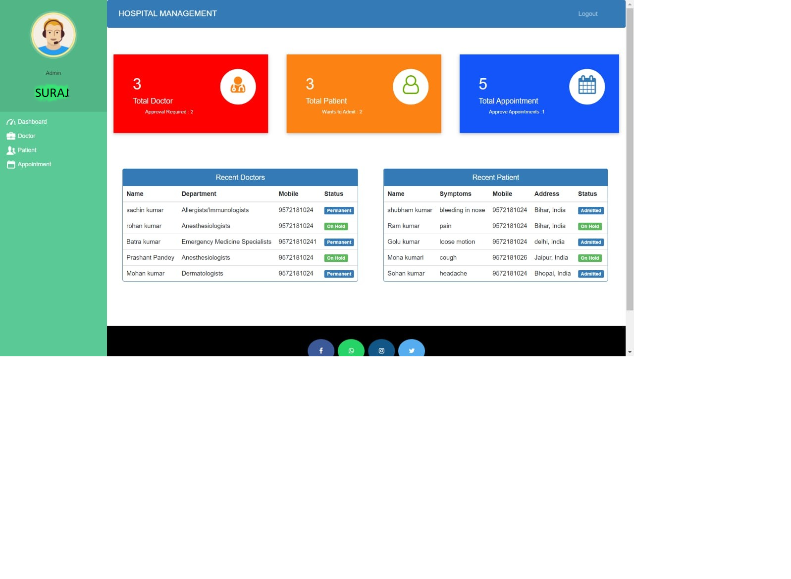
4.3.4 USER INTERFACE DESIGN
HOMEPAGE
ADMIN DASHBOARD

Slide 31
4.5 SECURITY ISSUES
Overview of Data Security Issues in Hospital Information Systems / Masrom and Rahilly Pacific Asia Journal of the Association for Information Systems adequate articles.
that related to the topic, then we analyse the articles by separating, connecting, comparing, selecting and describing them.
Finally, we discussing and synthesizing the previous researches to reach to the result.
For writing, the results derived from each article then summarized as findings of this study.
Data Security Issues Data security is a eld complex fit deals with several issues and problems, and provides several solutions as a security and privacy can threaten in the several ways.
Solutions normally lead to obstructions in normal use.
A global preserving and security solution have to begin with security guideline, security rules and set of the internal privacy definition.
These rules must exactly define where the physical place of data is in each stage of lifecycle and they specify how to treat the sensitive data, where it can appear.
At the end, patient education is so essential, they should know how the security protecting work and they know about how to resist about the attacker.

Slide 32
4.6 TEST CASES DESIGN
Verify that the portal for new patient registration has all the mandatory fields required for registering a patient.
Verify that after filling the patient details and successful payment a Patient-Card is printed.
Verify that card has information like patient details, doctor assigned, department, the application number, DOJ, bed allocated (if applicable) etc.
Verify that after patient check-up based on the requirement the details are updated in the patient details database.
Verify that for existing patients based on the application number of the patient, their records are added/updated in the database.
Verify that the system has an admin for doctors as well.
Verify that for each doctor’s details like their timings, specialty, fee, patient visited etc is visible to the authorized users.
Verify that new details of new doctors can be added to the system.
Verify that the details of existing users can be updated in the system.
Verify that the doctor’s record can be deleted from the system.
Verify the billing admin of the system calculates the bill based on the patient’s unique application number from the data generated from different systems.
Verify that the hard copy of the bill can be generating by printing the bill.
Verify that authorized users can also see total day-wise billing done.

Slide 33
implementation and testing
CHAPTER NO. 5
Go!

Slide 34
5.1 IMPLEMENTATION APPROACHES
we know, creating software is one thing and the implementation of the created software is another.
The process of implementing software is much difficult as compared to the task of creating the project. First, we have to implement the software on a small scale for removing the bugs and other errors in the project and after removing them we can implement the software on a large scale.
Before we think in terms of implementing the Software on a large basis, we must consider the Hardware requirements. Whenever we develop software or project a certain hardware and software is being used by the programmer for developing the project.
The hardware and software to be used by the programmer for developing the project should be such that it would result in the development of a project, which would satisfy all the basic needs for which the project
The Hardware should be such that cost constraints of the Client should also be taken into account without affecting the performance.

Slide 35
5.2 TESTING approaches
Unit Testing: This is the smallest testable unit of a computer system and is normally tested using the white box testing. The author of the programs usually carries out unit tests. In the unit testing the analyst tests the program making up a system.
Integration Testing: In integration testing, the different units of the system are integrated together to form the complete system and this type of testing checks the system as whole to ensure that it is doing what is supposed to do. The testing of an integrated system can be carried out top-down, bottom-up, or big-bang.
Beta Testing : These forms of testing are adopted at the development and pre-release stages and involve the testing of regulatory requirements and production readiness.
beta testing the testing of a vendor’s product—a device, equipment, hardware or software—by applications-knowledgeable users who are familiar with the product’s uses or potential uses.

Slide 36
5.3 MODIFICATION AND IMPROVEMENT
This application avoids the manual work and the problems concern with it. It is an easy way to obtain the information regarding the various travel services that are present in our System.
Well, I and my team member have worked hard in order to present an improved website better than the existing one’s regarding the information about the various activities. Still, we found out that the project can be done in a better way.
By using this patient will send request for consulting the doctor. Reception will set the date for doctor appointments. After that doctor see his appointments and see the patients, surgeries also done.
The next enhancement is, we will develop online services. That mean, if patient have any problems, he can send his problem to the doctor through internet from his home then doctor will send reply to him.

Slide 37
5.4 test cases
Check by entering the correct URL in the browser, and the application should be loading properly.
Check is there any user verification functionality present on the application.
Check by entering valid credential like username and password user should be able to log in.
Check by entering invalid credentials the user should not be login into the application, and an error message should be displayed.
Check is the hospital management system application has an option to add a new patient.
Check whether all the mandatory fields are present registration portal.
Check after adding a new patient, and after completion of the payment process, the patient cards should be printed.
Check whether the patient card has the details like assign doctor name comma department, present application number command date of join and also located bed details, etc.
Check the number of roles in the hospital management system like the patient, doctor, admin, accountant, etc.
Check that the authorized users can see the doctor details in the portal like the doctors’ timings and fees.
Check if there is any functionality to add a new doctor in the hospital management system, for instance, we have added patient details in the database.
Check whether the admin users can delete doctor and patient information by the hospital management system portal
Check after the formation of a bill that should be an option to print the bill or to generate a hard copy of the bill.
Check the authorized users have the privilege to check the details report of the patients like day wise
Check the admin has all the access

Slide 38
RESULTS AND DISCUSSION
CHAPTER NO. 6
Go!

Slide 39
6.1 Test Report
Test Report is a document which contains a summary of all test activities and final test results of a testing project. Test report is an assessment of how well the Testing is performed. Based on the test report, stakeholders can evaluate the quality of the tested product and make a decision on the software release.
For example, if the test report informs that there are many defects remaining in the product, stakeholders can delay the release until all the defects are fixed.
To solve that problem, a good Test Report should be:
Detail: You should provide a detailed description of the testing activity, show which testing you have performed. Do not put the abstract information into the report, because the reader will not understand what you said.
Clear: All information in the test report should be short and clearly understandable.
Standard: The Test Report should follow the standard template. It is easy for stakeholder to review and ensure the consistency between test reports in many projects.

Slide 40
6.2 USER DOCUMENTATION
User manual of Hospital Management System
• Login and make basic admin account
Before Enter to the system the user must need basic Admiration user login information to login to system. If you do not have user account, you can simply click on register here for mage user account.
User must file the all the fields in registration from after submitting valid data to registration.
User can simply enter data to login form and can enter to software main menu.
In the main menu, you can use the navigation bar or navigate buttons to navigate around the application.
After the main steps, before working with system make super admin account is the best way to start system.
• Setup super user account
To make super admin account user must needs to top level admin. You can create super admin
account by clicking Super admin account from navigation bar.
After entering to super admin function user need top level admin username and password to

Slide 41
login to create super admin account.
USERNAME = Admin
PASSWORD = Password
After adding login information of top level admin account, you can go to top level admin account
Options for top level admin function
• Super Admin Options
• Insert super admin.
In insert super administration user able to make super administration account, making
super administration account same as basic admin account creation.
• Delete Super administration
In Delete super administration top level user can delete super admin account.
• Basic Admin Options
• Insert Basic Admin
In insert Basic administration user able to make Basic administration account.
• Delete Basic Admin
In Delete Basic administration top level user can delete super admin account.
Both Super Admin Options and Basic Admin Options has same process.

Slide 42
CONCLUSIONS
CHAPTER NO. 7
Go!

Slide 43
7.1 Conclusion
In Conclusion, from a proper analysis and assessment of the designed system, it can be safely conclude that the system is an efficient, usable and reliable records management system. It is working properly and adequately meets the minimum expectations that were set for it initially. The new system is expected to give benefits increased overall productivity, performance and efficient records management.
7.1.1 significance
The health system is one of essential socio-economic activities; therefore, it requires rational and effective management. For this, it is necessary to have a tool that allows adequate control of the information generated in health institutions.
Hospitals, as the main actors of the health system, generate an essential volume of information, but in most cases, it is dispersed or not available in the necessary time and manner.
7.2 Future work
This application avoids the manual work and the problems concerned with it. It is an easy way to obtain the information regarding the various travel services that are present in our System. We intend to develop the project by make it comprehensive all the aspect of the hospital management like the add birth and death records, make the system ask patient for payment (bill) when a patient resolve to departure after treatment another aspect of hospital. The next enhancement is, we will develop online services. That mean, if patient have any problems, he can send his problem to the doctor through internet from his home then doctor will send reply to him In this patients have some login name and password. The doctor can ask opinion of a doctor in another hospital or elsewhere the case of certain.

Slide 44
7.3 LIMITATION
Few Challenging problems that you face while implementing HMS
Human Challenges:
While considering the human factors, they include Awareness of HMS advantages & importance.
In general, Experience, and knowledge of using computer applications.
Impressions and Beliefs regarding HMS and making use of them efficiently.
The researchers in a study have identified three main human challenges that are being a barrier in adopting the HMS in healthcare industries namely.
Shortage of professional healthcare faculty who have in-depth knowledge of HMS and other similar technologies.
Technical Challenges:
Other few technical challenges that fail the implementation of HMS in the healthcare industry includes Networks and computer have different maintenance problems, lack of no standards for Data entry and data retrieval, difficulties in training users technically to use HMS.

Slide 45
REFERENCES
https://www.wikipedia.org
https://github.com
https://www.slideshare.net
www.google.com
www.youtube.com

Slide 46
thank you

